Slide 1
CS378 - Mobile Computing
Android Overview and Android Development Environment

Slide 2
What is Android?
A software stack for mobile devices that includes
An operating system
Middleware
Key Applications
Uses Linux to provide core system services
Security
Memory management
Process management
Power management
Hardware drivers

Slide 3
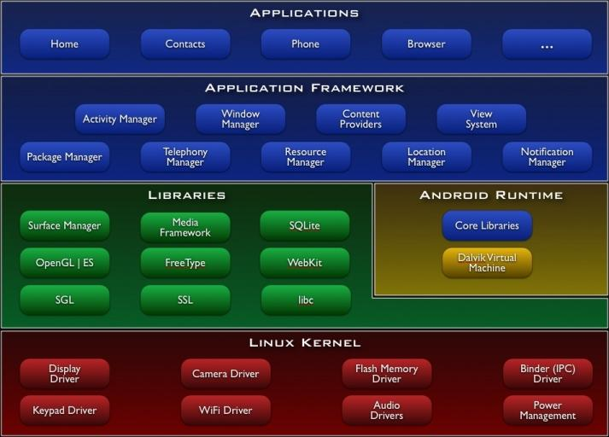
http://developer.android.com/guide/basics/what-is-android.html

Slide 4
Android Features
Application framework enabling reuse and replacement of components
Dalvik virtual machine optimized for mobile devices
Integrated browser based on the open source WebKit engine
Optimized graphics powered by a custom 2D graphics library; 3D graphics based on the OpenGL ES 1.0 specification (hardware acceleration optional)
SQLite for structured data storage
Media support for common audio, video, and still image formats (MPEG4, H.264, MP3, AAC, AMR, JPG, PNG, GIF)
GSM Telephony (hardware dependent)
Bluetooth, EDGE, 3G, and WiFi (hardware dependent)
Camera, GPS, compass, and accelerometer (hardware dependent)
Rich development environment including a device emulator, tools for debugging, memory and performance profiling, and a plugin for the Eclipse IDE
http://developer.android.com/guide/basics/what-is-android.html

Slide 5
A Short History Of Android
2001 Palm Kyocera 6035, combing PDA and phone
2003 - Blackberry smartphone released
2005
Google acquires startup Android Inc. to start Android platform.
Work on Dalvik VM begins
2007
Open Handset Alliance announced
Early look at SDK
June, iPhone released
2008
Google sponsors 1st Android Developer Challenge
T-Mobile G1 announced, released fall
SDK 1.0 released
Android released open source (Apache License)
Android Dev Phone 1 released
Pro Android by Hashimi & Komatineni (2009)

Slide 6

Short History cont.
2009
SDK 1.5 (Cupcake)
New soft keyboard with “autocomplete” feature
SDK 1.6 (Donut)
Support Wide VGA
SDK 2.0/2.0.1/2.1 (Eclair)
Revamped UI, browser
2010
Nexus One released to the public
SDK 2.2 (Froyo)
Flash support, tethering
SDK 2.3 (Gingerbread)
UI update, system-wide copy-paste

Slide 7

Short History cont.
2011
SDK 3.0 (Honeycomb) for tablets only
New UI for tablets, support multi-core processors, fragments
SDK 3.1 and 3.2
Hardware support and UI improvements
SDK 4.0 (Ice Cream Sandwich)
For Q4, combination of Gingerbread and Honeycomb

Slide 8
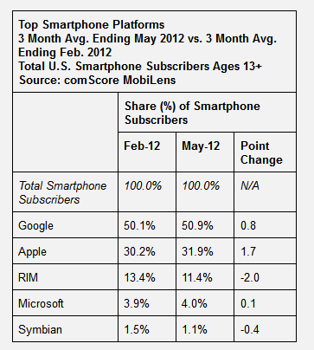
Short History cont.
2012
Android 4.1, "Jelly Bean" announced late June 2012

Slide 9
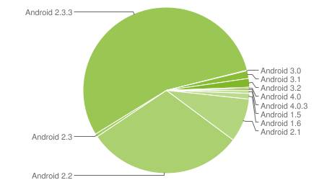
Device Distribution Jan 2012
Based on active devices
Forward compatible
Not necessarily backward compatible
1.5 Cupcake: 0.6%
1.6 Donut: 1.1%
2.1 Ecliar 8.5%
2.2 Froyo 30.4%
2.3 Gingerbread: 56%
3.X Honeycomb 3.3%
4.x Ice Cream Sand. 0.6%
http://developer.android.com/resources/dashboard/platform-versions.html

Slide 10
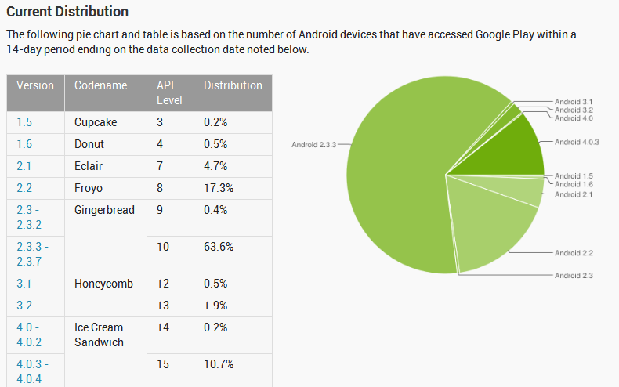
Device Distribution July 2012

Slide 11
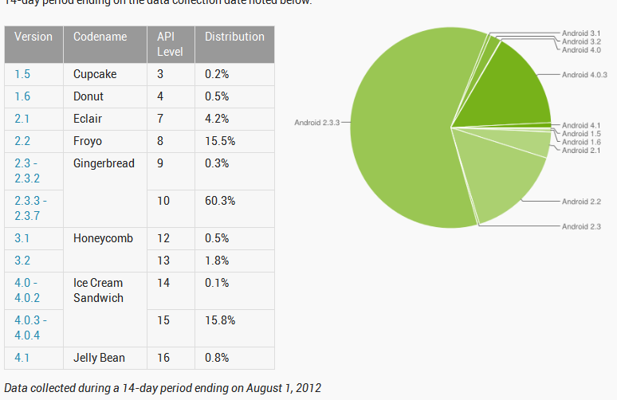
August 1, 2012

Slide 12
Devices and Apps
Estimated 400M activated devices (100M a year ago)
1M new activations per day
Google Play (formerly Android Market)
~600,000 apps, June 2012
2/3 free, 1/3 paid
Apple App Store, ~650,000 apps June 2012
What's old is new - Mac vs. PC iPhone vs. Android???

Slide 13

iPhone vs. Android

Slide 14
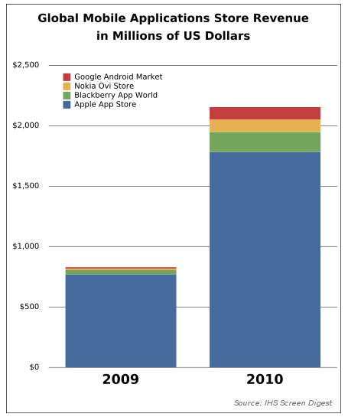
Developer Revenues
Business Strategy: attract developers with comparison of revenue generated by applications, average revenue per user, etc.

Slide 15
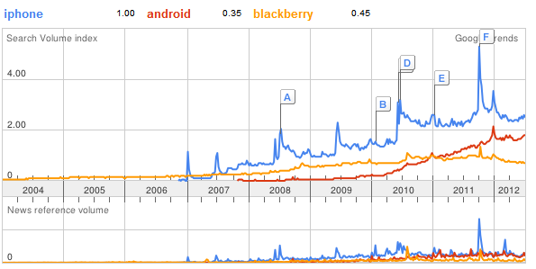
Search Trends

Slide 16
Setup Development Environment
Install JDK 5, 6, or 7
Install Eclipse IDE (version 3.7 - Indigo)
recommended "Eclipse Classic"
Download and unpack the Android SDK
Install Android Development Tools (ADT) plugin for Eclipse
Detailed install instructions available on Android site http://developer.android.com/sdk/installing.html

Slide 17
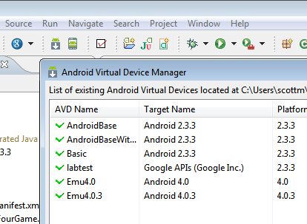
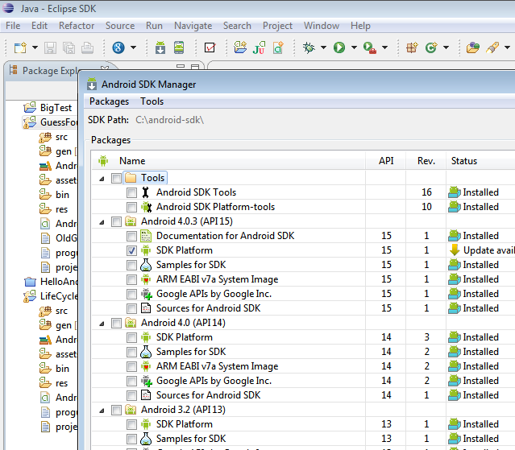
AVD Manager
SDK Manager

Slide 18
Android Emulator or AVD
Emulator is essential to testing app but is not a substitute for a real device
Emulators are called Android Virtual Devices (AVDs)
Android SDK and AVD Manager allows you to create AVDs that target any Android API level
AVD have configurable resolutions, RAM, SD cards, skins, and other hardware

Slide 19
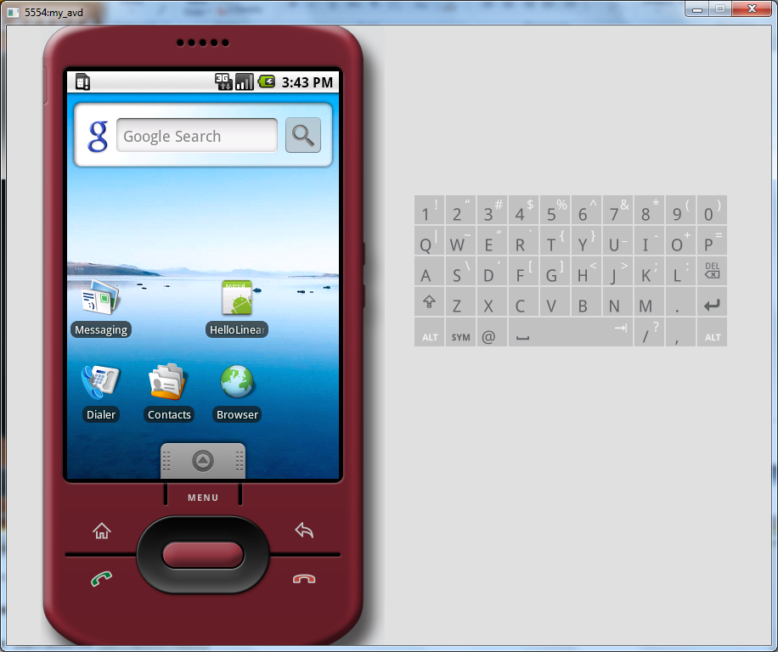
Android Emulator: 1.6

Slide 20
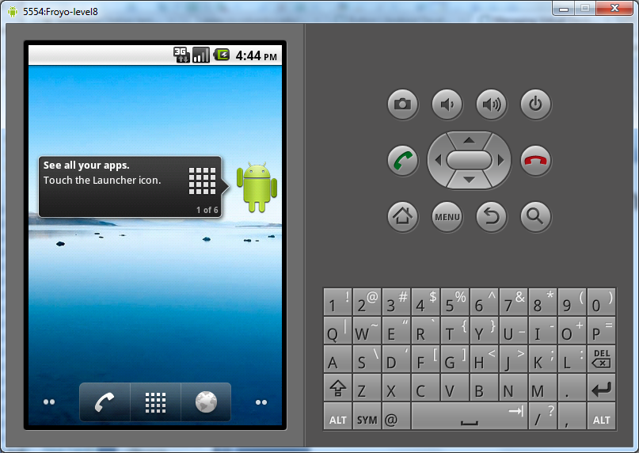
Android Emulator: 2.2

Slide 21
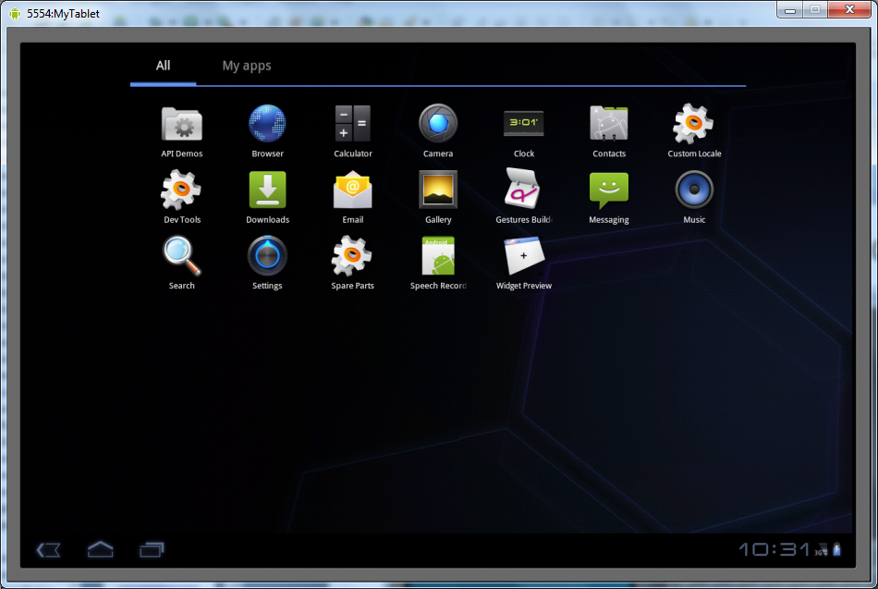
Android Emulator: 3.0

Slide 22
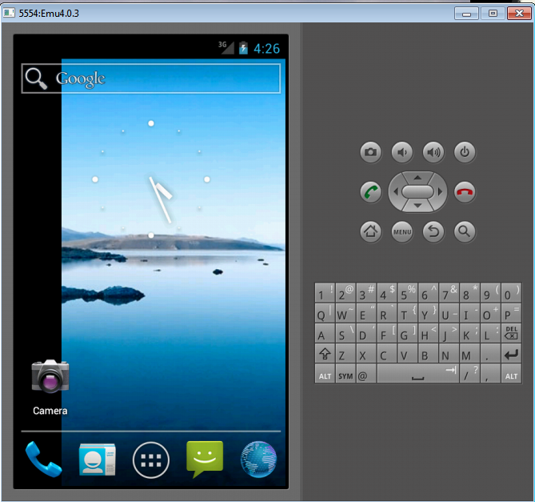
Android Emulator: 4.0

Slide 23
Emulator Basics
Host computer’s keyboard works
Host’s mouse works like finger
Uses host’s Internet connection
Other buttons work: Home, Menu, Back, Search, volume up and down, etc.
Ctrl-F11 toggle landscape 🡪 portrait
Alt-Enter toggle full-screen mode
More info at http://developer.android.com/guide/developing/devices/emulator.html

Slide 24
Emulator Limitations
No support for placing or receiving actual phone calls
Simulate phone calls (placed and received) through the emulator console
No support for USB connections
No support for camera/video capture (input)
No support for device-attached headphones
No support for determining connected state
No support for determining battery charge level and AC charging state
No support for determining SD card insert/eject
No support for Bluetooth
No support for simulating the accelerometer
Use OpenIntents’s Sensor Simulator
That's why we need the dev phone!

Slide 25
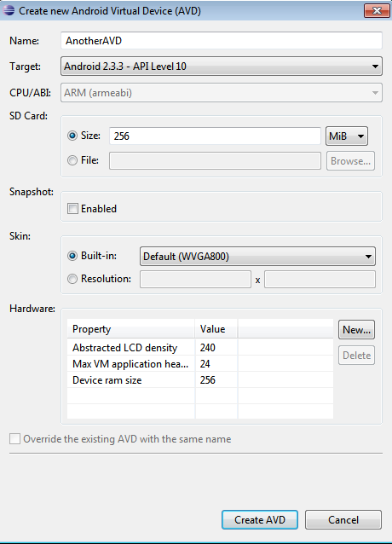
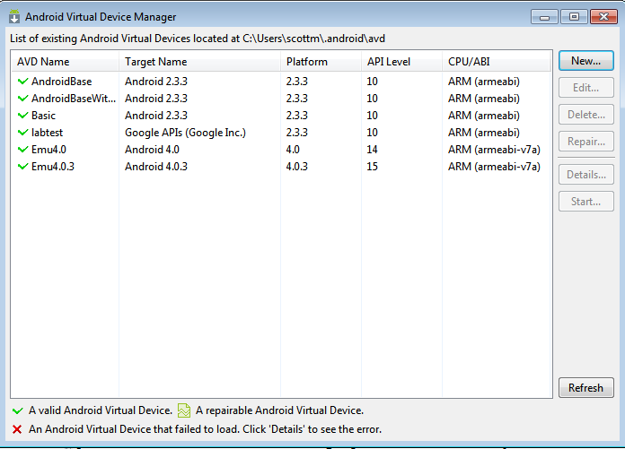
Create an AVD using AVD Manager
or use the command line http://developer.android.com/guide/developing/devices/managing-avds-cmdline.html

Slide 26
Android Runtime: Dalvik VM
Subset of Java developed by Google
Optimized for mobile devices (better memory management, battery utilization, etc.)
Dalvik runs .dex files that are compiled from .class files
Introduces new libraries
Does not support some Java libraries like AWT, Swing
http://developer.android.com/reference/packages.html

Slide 27
Or From the Command Line
C:\android-sdk-windows\tools>android create avd -n MyDevice -t android-8
Android 2.2 is a basic Android platform.
Do you wish to create a custom hardware profile [no]
Created AVD 'MyDevice2' based on Android 2.2,
with the following hardware config:
hw.lcd.density=240
vm.heapSize=24
C:\android-sdk-windows\tools>emulator -avd MyDevice
Device name
Target platform
Launch device
More info: http://developer.android.com/guide/developing/devices/managing-avds-cmdline.html

Slide 28
Applications Are Boxed
By default, each app is run in its own Linux process
Process started when app’s code needs to be executed
Threads can be started to handle time-consuming operations
Each process has its own Dalvik VM
By default, each app is assigned unique Linux ID
Permissions are set so app’s files are only visible to that app

Slide 29


Producing an Android App
Java code
javac
Byte code
Dalvik exe
dx
.java
.class
classes.dex
aapt
Byte code
<xml>
Other .class files
AndroidManifest.xml
.apk
<str>
Resources
Notes:
Every application must have an AndroidManifest.xml file (with precisely that name) in its root directory. The manifest presents essential information about the application to the Android system, information the system must have before it can run any of the application's code. Among other things, the manifest does the following:
It names the Java package for the application. The package name serves as a unique identifier for the application.
It describes the components of the application — the activities, services, broadcast receivers, and content providers that the application is composed of. It names the classes that implement each of the components and publishes their capabilities (for example, which Intent messages they can handle). These declarations let the Android system know what the components are and under what conditions they can be launched.
It determines which processes will host application components.
It declares which permissions the application must have in order to access protected parts of the API and interact with other applications.
It also declares the permissions that others are required to have in order to interact with the application's components.
It lists the Instrumentation classes that provide profiling and other information as the application is running. These declarations are present in the manifest only while the application is being developed and tested; they're removed before the application is published.
It declares the minimum level of the Android API that the application requires.
It lists the libraries that the application must be linked against.

Slide 30
Other Dev Tools
Android Debug Bridge
Part of SDK
command line tool to communicate with an emulator or connected Android device
check devices attached / running
install apk's, Android PacKage files, "executables", can find samples on places besides Android Market (security?)
and more!
http://developer.android.com/guide/developing/tools/adb.html

Slide 31
Dalvik Debug Monitor Server
DDMS
debugging tool
"provides, screen capture on the device, thread and heap information on the device, logcat, process, and radio state information, incoming call and SMS spoofing, location data spoofing, and more."
can interact with DDMS via Eclipse plugin, another view in Eclipse

Slide 32
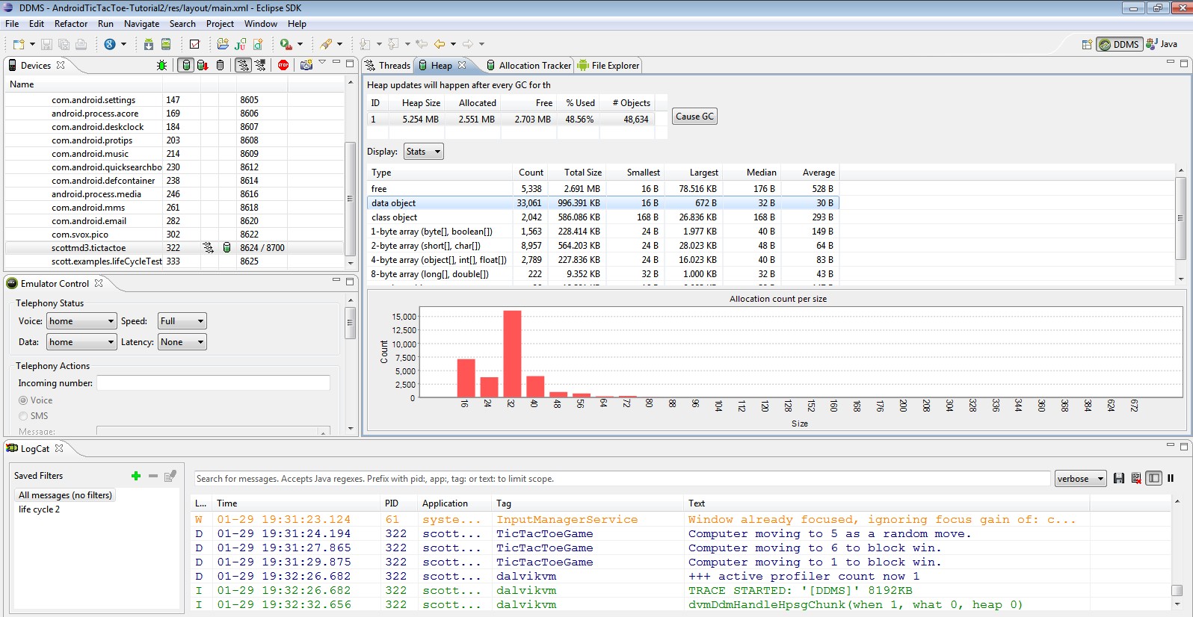
DDMS

